Slide 1

DATA ANALYTICS ACADEMIC PROJECT
Adventure Works Sales Performance
A Multi-Platform Business Intelligence Case Study utilizing SQL Server, Excel Power Pivot, Tableau, and Power BI reporting engines.
Presented by Group 1
Rohit • Vaibhav • Gagan • Deekhshith • Kavitha • Samita • Shraddha

Slide 2




Project Overview
The Problem Context
Technical Scope
Data Fragmentation: Adventure Works Cycles handles massive, un-consolidated historical internet sales records spanning multiple years and formats.
Lack of Visibility: Executive decision-makers lack a unified, multi-dimensional view of regional sales trends and shifting customer demographics.
Operational Inefficiencies: Without interactive tracking, identifying regional performance bottlenecks and inventory bottlenecks is slow and reactive.
This engineering project implements a complete pipeline utilizing a multi-tiered environment:
MySQL Engine: Heavy-duty queries, ETL mappings and table staging.
Excel Power Pivot: Relational model design and core KPI evaluations.
Tableau & Power BI: High fidelity analytical dashboard architectures.

Slide 3
Strategic Objective
Target Business Metrics
The core directive of our analytical modeling is to deliver functional, high-fidelity visual assets that allow decision-makers to track sales health in real time.
Identify Performance Vectors: Track quarterly net revenues, localized profit contributions, and baseline overhead values.
Improve Customer Targeting: Segment target buyer behaviors across nations and distinct gender profiles.
Integrate Insights: Ensure identical reporting logic is implemented flawlessly across our analytical suites.

Slide 4







Tools Used
SQL Server
Tableau
Structured raw transactional data tables, mutated schema structures, performed joins across entities, and established indices to accelerate querying throughput.
Deployed sophisticated interactive reports utilizing dynamic geo-spatial Mapbox mapping to evaluate performance distribution at region and city levels.
Excel
Power BI
Modeled initial multi-entity table connections, built calculated column formulations, and engineered core corporate KPIs using dynamic pivot charts.
Crafted fully responsive enterprise dashboards featuring active cross-filtering and synchronized slicers for high-volume transactions analysis.

Slide 5






Dashboard KPIs
KPI-1 & KPI-2
Yearly & Monthly Sales
Tracks longitudinal performance curves and seasonal spikes across transaction histories.
KPI-5
Gender-wise Distributions
Deconstructs demographic sales splits to analyze purchase behaviors of target customer personas.
KPI-3
Quarterly Sales Performance
Segments sales velocity into distinct quarterly phases to measure periodic trajectory metrics.
KPI-6
KPI-4
Monthly Cost vs Profit Amount
Benchmarks operational gross production cost allocations against net profits month over month.
Country-wise Performance
Illustrates geo-spatial market dominance and traces regional revenue density shifts.

Slide 6
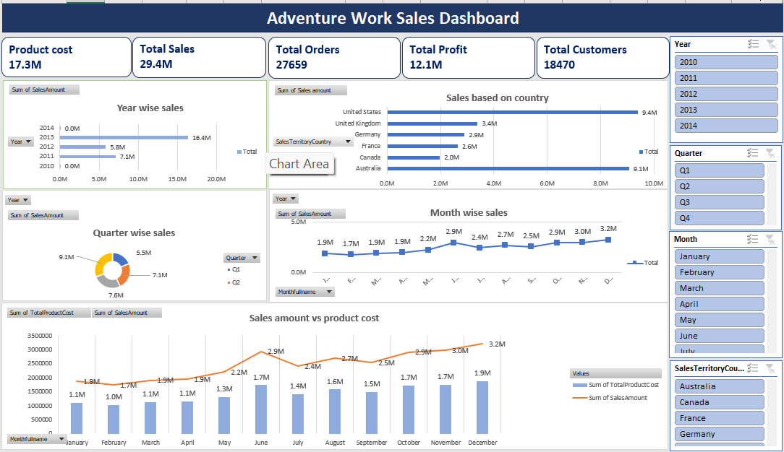
Excel Dashboard Platform

Slide 7
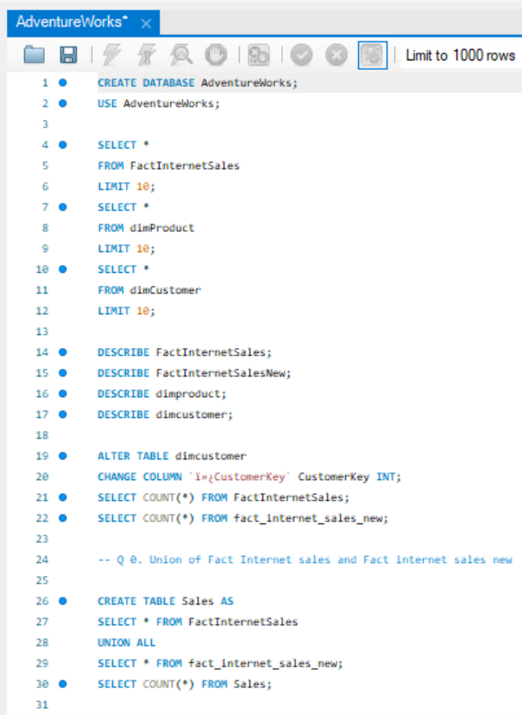
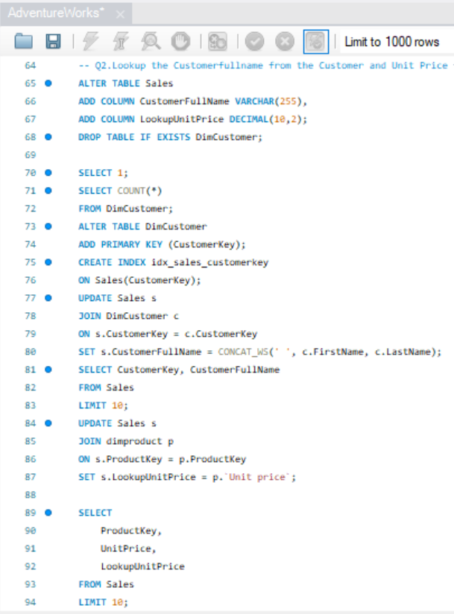
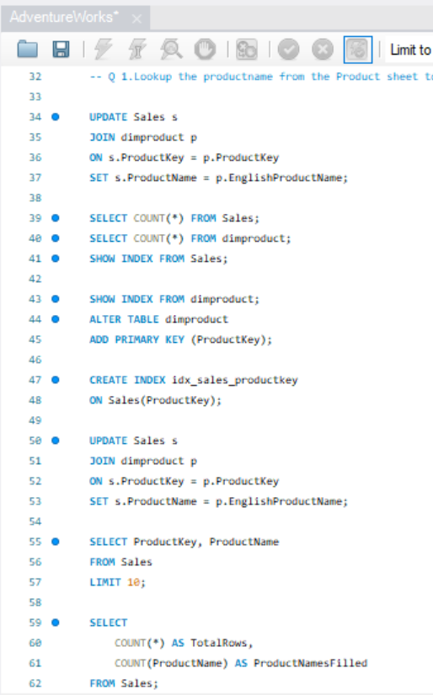
SQL QUERIES

Slide 8
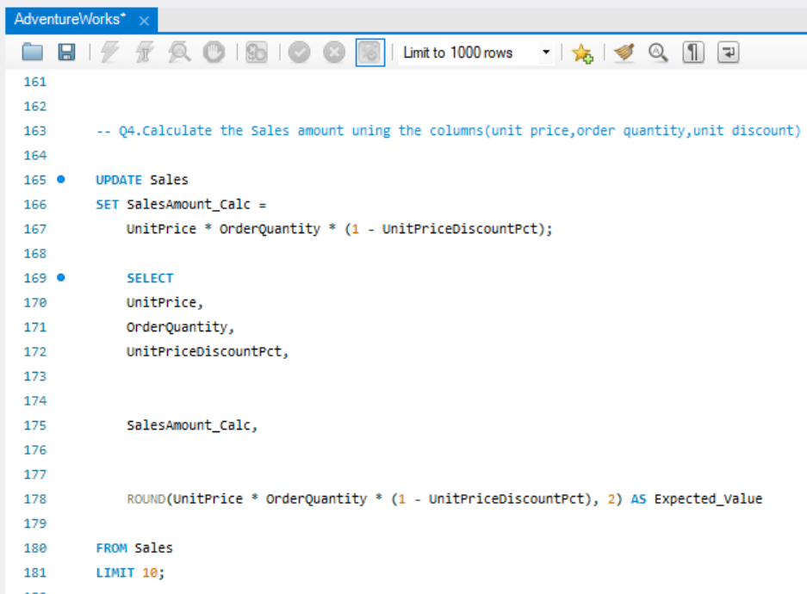
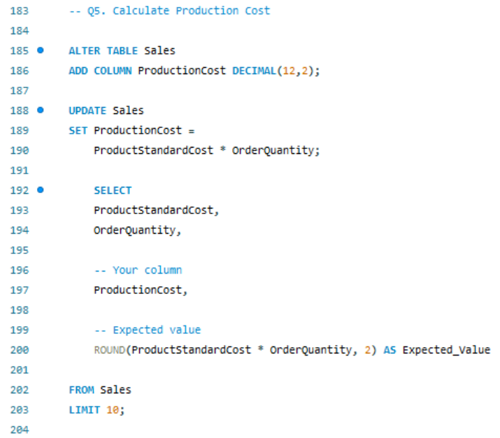
SQL QUERIES

Slide 9
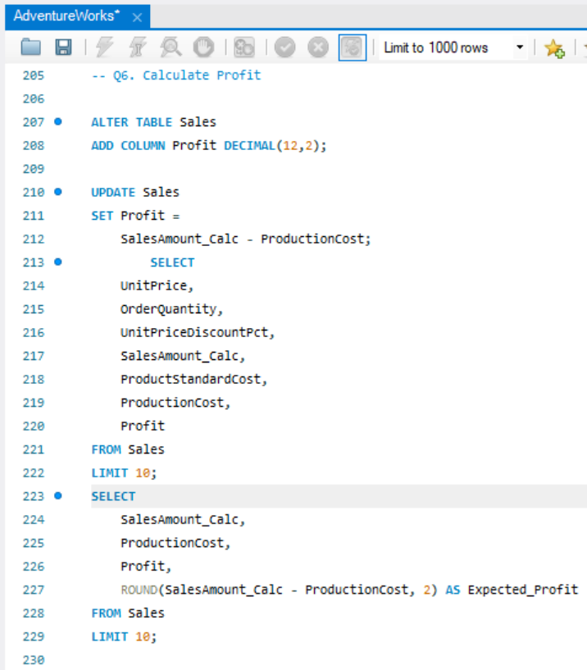
SQL QUERIES

Slide 10
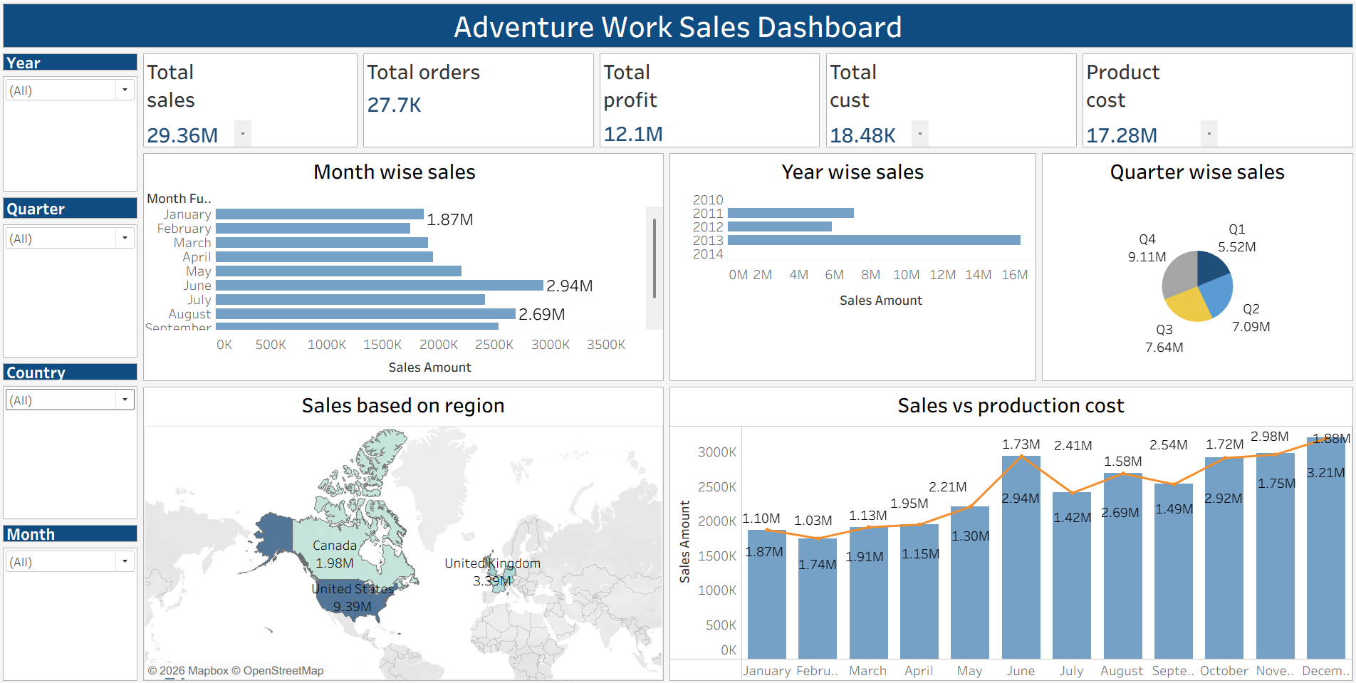
Tableau Spatial Analytics

Slide 11
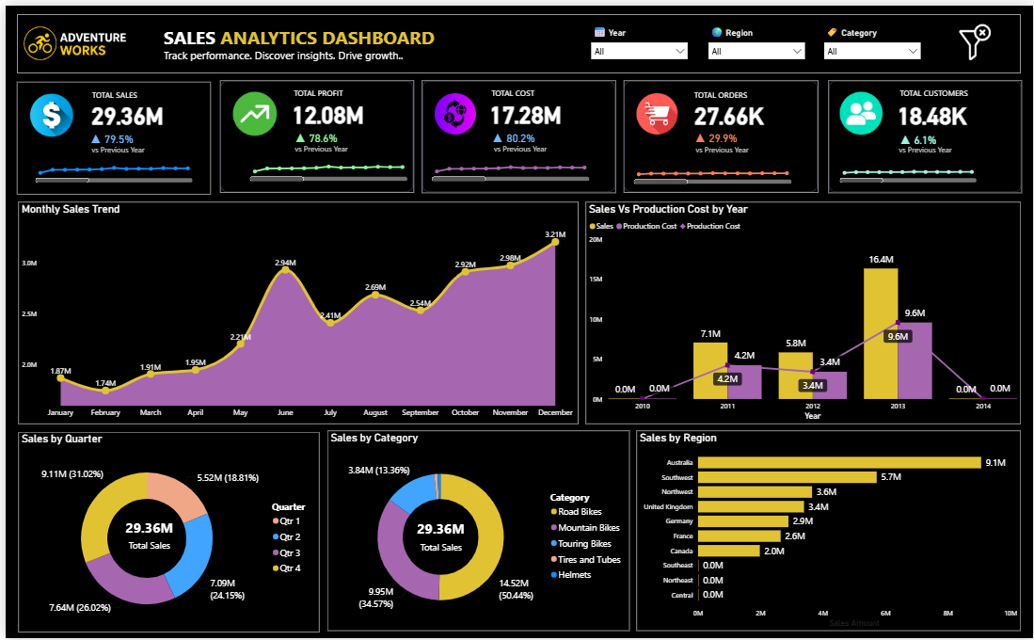
Power BI Reporting

Slide 12
Project Conclusions
Outstanding Sales Volume: Dashboards reveal a robust gross generation value of $29.4M over the tracked historical timeline.
Highly Concentrated Revenue: The United States represents the dominant geographic sales engine with $9.39M in total sales, followed by the United Kingdom with $3.39M.
Dynamic Seasonal Cycles: Volume trends highlight a robust monthly sales curve peaking in June ($2.94M) and late Q4 ($3.21M in December).
Healthy Profitability Margins: The enterprise maintained excellent profitability metrics, yielding $12.1M in net profit margins against total production costs of $17.3M.
Unified Database Architecture: Normalizing transactional staging schemas in SQL secured absolute numeric parity across Excel, Tableau, and Power BI analytics platforms.

Slide 13
ADVENTURE WORKS SALES ANALYSIS
Thank You
Presented by Group 1

